Slide 1
Libraries and calling functions

Slide 2
Outline
In this lesson, we will:
Describe the concept of a library
Look at the C math library
Look at the global variables defined in that library
Describe a function declaration
Look at how to call a function with arguments
Understand how to use the returned value
Look at a number of examples

Slide 3
Using other code
In our examples so far, we have performed
Arithmetic, comparison and logical operations
Assignments
Conditional statements and repetition statements
How do we use someone else’s code?
Suppose we are simulating a cyclic system and require the use of trigonometric functions?

Slide 4
Review of functions
Recall from secondary school that functions took arguments:
sin(x) ln(x) gcd(m, n)
For example, you may have used
sin(π/6) ln(3) gcd(15, 18)
In secondary school, you may have said:
The sine function takes a real value as an argument and returns a real value on the interval [–1, 1]
The natural logarithm takes a positive real value as an argument and returns a real value
The gcd takes two integers and returns a positive integer

Slide 5
Functions in C++
A function in C++ is a body of instructions that:
Allows you to specify certain parameters
Calculates or returns a value based on those parameters
For example, there are C++ functions that calculate:
sin(x) ln(x) gcd(m, n)
Functions avoid the need to reinvent the wheel
E.g., someone else has already authored the trigonometric functions

Slide 6
Libraries
The solution for collecting related functions together for re-use in C++ is a library
Suppose you need information on something:
You go to an appropriate library, and access that book
A C++ library can be
A collection of functions that you can call from your program
A collection of global variables you can access
Other objects and classes associated with object-oriented design
We will see this later in this course

Slide 7
Libraries
We will examine the C math library
This is a collection of mathematical constants and functions
You access the C math library by including
#include <cmath>
As you may guess, iostream is another library
#include <iostream>

Slide 8
Global variables
First, the global variables, all of type double:
M_E | e | 2.71828182845904523536
M_LOG2E | log₂(e) | 1.44269504088896340736
M_LOG10E | log₁₀(e) | 0.434294481903251827651
M_LN2 | ln(2) | 0.693147180559945309417
M_LN10 | ln(10) | 2.30258509299404568402
M_PI | π | 3.14159265358979323846
M_PI_2 | π/2 | 1.57079632679489661923
M_PI_4 | π/4 | 0.785398163397448309616
M_1_PI | 1/π | 0.318309886183790671538
M_2_PI | 2/π | 0.636619772367581343076
M_2_SQRTPI | 2/√π | 1.12837916709551257390
M_SQRT2 | √2 | 1.41421356237309504880
M_SQRT1_2 | 1/√2 | 0.707106781186547524401

Slide 9
Example
These can be used in a program:
#define _USE_MATH_DEFINES // This is required for some IDEs and compilers
#include <cmath>
#include <iostream>
// Function declarations
int main();
// Function definitions
int main() {
double radius{};
std::cout << "Enter the radius of a sphere: ";
std::cin >> radius;
double area{4.0*M_PI*radius*radius};
double volume{(4.0/3.0)*M_PI*radius*radius*radius};
std::cout << "The surface area is " << area << std::endl;
std::cout << "The volume is " << volume << std::endl;
return 0;
}
Output:
Enter the radius of a sphere:
2
The surface area is 50.2655
The volume is 33.5103

Slide 10
Function declarations
The C math library also contains a number of functions you can use
Each function is described by the function declaration
The function declaration for the sine function is
double sin( double x );
The function that calculates x^{y} is
double pow( double x, double y );
It evaluates to or
returns a float
It takes a single float
as an argument
It evaluates to or
returns a float
It takes two floats
as arguments

Slide 11
Function declarations
If this library had a gcd function, its function declaration would be:
int gcd( int m, int n );
The function declaration may also be described as the:
signature
prototype
interface
of the function
You have already seen one function declaration in this course:
int main();
It evaluates to or
returns an integer
It takes two integers
as arguments

Slide 12
Trigonometric functions
Some function declarations in the cmath library are:
double cos( double x );
double sin( double x );
double tan( double x );
double acos( double x );
double asin( double x );
double atan( double x );
double atan2( double y, double x );
Immediately, you may notice:
If you want sec(x), you must use 1/cos(x)
More interesting is atan2(…):
It returns tan^{–1}(y/x), but takes into account the sign of y and x
This allows, for example, x = 0

Slide 13
Trigonometric functions
Here are examples of calling functions
That is, we are calling the function with an argument or arguments
#define _USE_MATH_DEFINES
#include <cmath>
#include <iostream>
// Function declarations
int main();
// Function definitions
int main() {
double x{};
std::cout << "Enter a real value 'x': ";
std::cin >> x;
std::cout << " sin(" << x << ") = " << std::sin(x) << std::endl;
std::cout << " cos(" << x << ") = " << std::cos(x) << std::endl;
std::cout << "atan(" << x << ") = " << std::atan(x) << std::endl;
return 0;
}
Output:
Enter a real value 'x':
3
.
1
4
sin(3.14) = 0.00159265
cos(3.14) = -0.999999
atan(3.14) = 1.26248

Slide 14
Functions calls in arithmetic expressions
In any arithmetic expression where you could have used a float or local variable of type float, you can also use a call to a function that has a return type double
int main() {
double x{};
std::cout << "Enter a real value 'x': ";
std::cin >> x;
double y{std::sin(x) + 1.0};
std::cout << "sin(" << x << ") + 1 = " << y << std::endl;
y = std::sin(std::asin(x));
std::cout << "sin(asin(" << x << ")) = " << y << std::endl;
y = std::cos(M_PI_2 - std::asin(x));
std::cout << "cos(pi/2 - asin(" << x << ")) = " << y << std::endl;
return 0;
}
Output:
Enter a real value 'x':
0
.
3
2
sin(0.32) + 1 = 1.31457
sin(asin(0.32)) = 0.32
cos(pi/2 - asin(0.32)) = 0.32

Slide 15
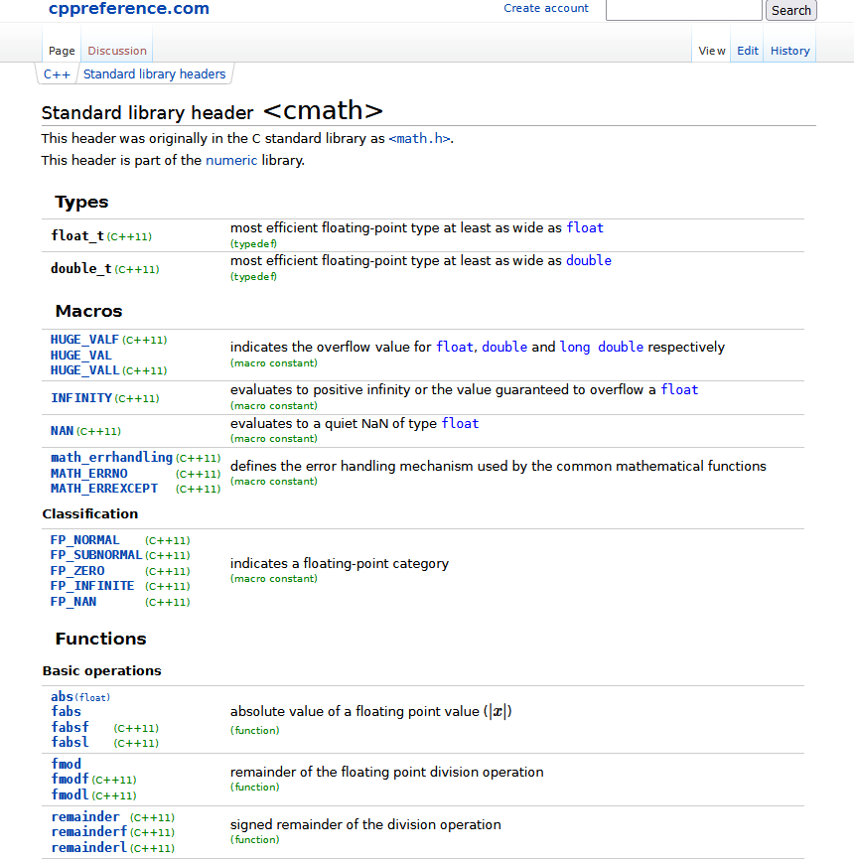
Other functions
Other functions in the cmath library are:
https://en.cppreference.com/w/cpp/header/cmath

Slide 16
A nice example
int main() {
double a{};
std::cout << "Enter a real value 'a': ";
std::cin >> a;
double b{};
std::cout << "Enter a real value 'b': ";
std::cin >> b;
int n{};
std::cout << "How many intervals? ";
std::cin >> n;
double h{(b - a)/n};
for ( int k{0}; k <= n; ++k ) {
std::cout << "(" << a + k*h << ", "
<< std::sin( a + k*h ) << ")" << std::endl;
}
return 0;
}
Output:
Enter a real value 'a': 2.5
Enter a real value 'b': 3.7
How many intervals 'n': 6
(2.5, 0.598472)
(2.7, 0.42738)
(2.9, 0.239249)
(3.1, 0.0415807)
(3.3, -0.157746)
(3.5, -0.350783)
(3.7, -0.529836)
n + 1 equally spaced points
n interals

Slide 17
An important takeaway
To use a function, all you need to know is:
The function declaration, which tells you
How many and the types of the arguments
The type of the return value
A description of what the function is supposed to accomplish
If the actual behavior of the function does not match the description,
this is a bug; that is, a situation where the expected returned value does not match the actual returned value
As long as you trust the author of the function,
you don’t have to know how the function is implemented
You probably shouldn’t care, either…

Slide 18
Summary
Following this lesson, you now:
Understand that libraries in C++ can contain global variables and functions
Know how to look at the function declaration and call that function
Know what you can do with the value returned by a function
Are aware of the C math library and some of its contents
Know that you can use a function
without understanding how it was implemented

Slide 19
References
[1] Cplusplus.com
http://www.cplusplus.com/reference/cmath/

Slide 20
Acknowledgments
None so far.

Slide 21
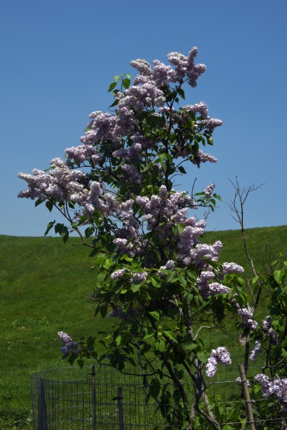
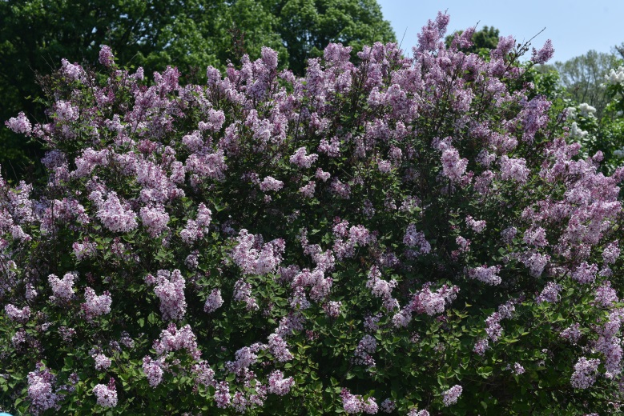
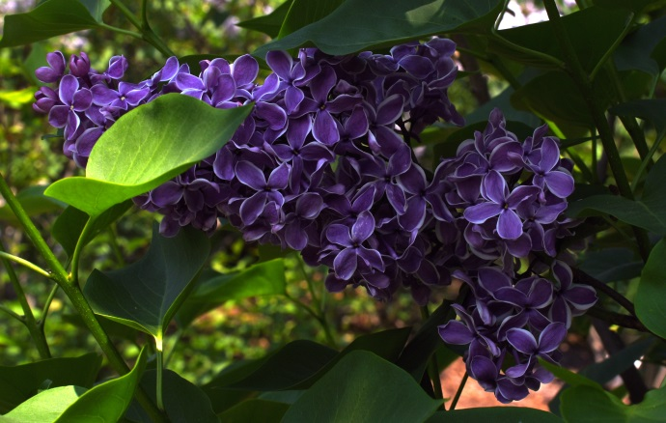
Colophon
These slides were prepared using the Georgia typeface. Mathematical equations use Times New Roman, and source code is presented using Consolas.
The photographs of lilacs in bloom appearing on the title slide and accenting the top of each other slide were taken at the Royal Botanical Gardens on May 27, 2018 by Douglas Wilhelm Harder. Please see
https://www.rbg.ca/
for more information.

Slide 22
Disclaimer
These slides are provided for the ece 150 Fundamentals of Programming course taught at the University of Waterloo. The material in it reflects the authors’ best judgment in light of the information available to them at the time of preparation. Any reliance on these course slides by any party for any other purpose are the responsibility of such parties. The authors accept no responsibility for damages, if any, suffered by any party as a result of decisions made or actions based on these course slides for any other purpose than that for which it was intended.

